Slide 1
MA3077 Operational Research Lecture 1 – Introduction & Linear Programming
Dr Marco Fasondini

Slide 2
Lecturer – Dr Marco Fasondini
About me: I obtained my PhD in 2018 and worked as a postdoctoral researcher at University of Kent and Imperial College London before joining Leicester in August 2022.
My research in numerical analysis is focused on using the remarkable properties of orthogonal polynomials to create improved methods for solving differential equations, with an eye on the equations used in weather forecasting. I also use computational and asymptotic methods to study differential equations in complex variables.​

Slide 3
Module organisation
Questions: please send me an email at m.fasondini@leicester.ac.uk
Lectures: See Blackboard
Tutorials: See Blackboard
Assessment: 20% coursework (2 problem sheets; for assessment schedule, see Blackboard) and 80% final exam
Learning material: Powerpoint slides are uploaded regularly on the Blackboard page.

Slide 4
Module outline
Linear programming
Queueing theory and game theory
Nonlinear optimisation
Mock exam

Slide 5
Prerequisites
The main prerequisites needed to follow this module are:
Linear algebra (mostly operations with vectors and matrices)
Calculus (mostly continuity and multivariate differentiation)
Elementary probability theory
Basic coding skills (mainly to solve large problems)
Coding: some exercises require numerical computations. In this module we use Matlab. If you need to refresh your knowledge of Matlab, have a look at this MathWorks tutorial (you may need to create a mathworks account to access it).

Slide 6
Recommended reading
The recommended textbooks are:
Hillier and Lieberman, Introduction to Operations Research, McGraw-Hill
Bosch, Opt Art: from Mathematical Optimization to Visual Design, Princeton University Press
Naadimuthu, R. Bronson, Operations Research, Schaum's Outlines
Nocedal and Wright, Numerical optimization, Springer
These are available on Blackboard (go to Readings and Sources).
Other useful websites are:
https://docs.mosek.com/modeling-cookbook/index.html#
https://www.theorsociety.com/
https://www.informs.org/
http://www.pitt.edu/~jrclass/or/or-intro.html
http://people.brunel.ac.uk/~mastjjb/jeb/or/intro.html

Slide 7
Lecture outline
Today's goal is to:
Introduce OR and the concepts of optimisation and linear programming,
learn how to solve linear programming problems using a graphical method
Today's lecture is loosely based on chapter 2.1 of the Mosek Cookbook

Slide 8
What is operational research?
Definition/description*: "operational research is a discipline that deals with the development and application of advanced analytical methods to improve decision-making."
"Employing techniques from other mathematical sciences, such as modeling, statistics, and optimization, operations research arrives at optimal or near-optimal solutions to complex decision-making problems. "
"Operations research is often concerned with determining the extreme values of some real-world objective: the maximum (of profit, performance, or yield) or minimum (of loss, risk, or cost)."
"Originating in military efforts before World War II, its techniques have grown to concern problems in a variety of industries."
* From wikipedia

Slide 9
Operational research in practice
The key steps of operational research are:
Understand the problem to be solved
Formulate a mathematical model
Collect relevant data
Compute the solution to the mathematical model
Validate the solution and possibly perform sensitivity analysis.

Slide 10
What is optimisation?
Optimisation is a technique to determine the best possible solution to a given problem.
This is done by first formulating a problem in mathematical terms, and then by applying suitable optimisation algorithms.
Formulating the problem in mathematical terms can be challenging. Coding it up can also require some skills.

Slide 11
Optimisation – key terms
To formulate the mathematical model, one must first identify:
the objective: a function that describes how "optimal" a configuration is, and that you aim to maximise or minimise (e.g., profit, cost, production,...)
the control/decision variables: what you can modify to maximise/minimise the objective function (e.g., resource allocation, ...)
the constraints: the conditions that the control variable must satisfy (e.g., time and resource constraints, ...)

Slide 12
An example – problem statement
Description: A chemical plant produces two compounds (compound A and B).
Producing 1 kg of compound A requires 1 kg of raw material and 8 processing hours, whereas 1 kg of compound B requires 2 kg of raw material and 7 processing hours.
Compound A can be sold at £80 per kg, whereas compound B at £120 per kg.
The market can absorb at most 3 kg of compound A.
The chemical plant currently owns 6 kg of raw material and has 28 processing hours available.
Question: How many kilograms of each compound should the plant produce to maximise the revenue?

Slide 13
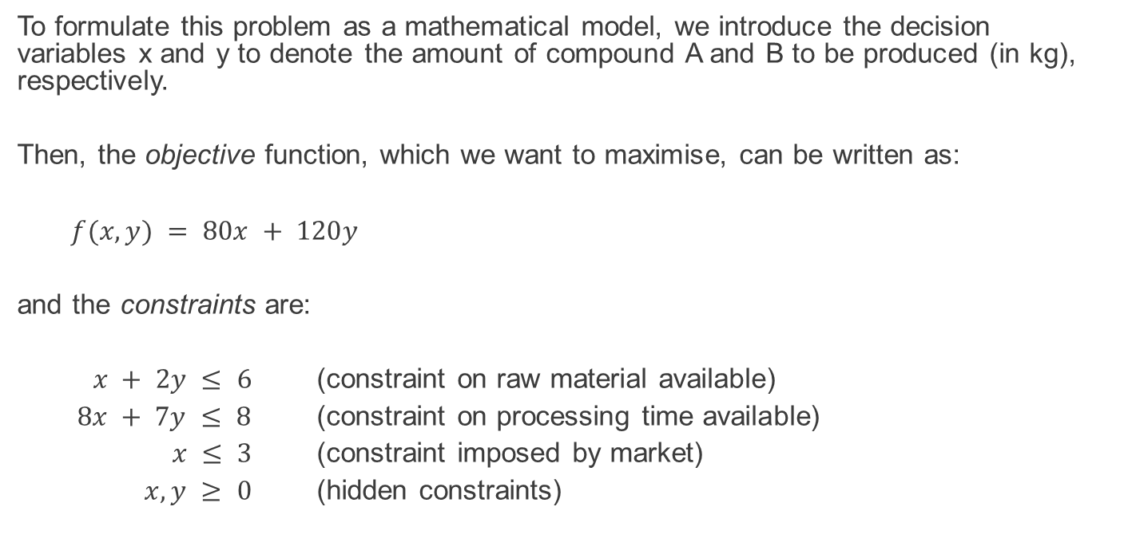
An example – mathematical formulation 1/2
To formulate this problem as a mathematical model, we introduce the decision variables x and y to denote the amount of compound A and B to be produced (in kg), respectively.
Then, the objective function, which we want to maximise, can be written as:
$$f(x,y) = 80x + 120y$$
and the constraints are:
$x + 2y ≤ 6$ (constraint on raw material available)
$8x + 7y ≤ 8$ (constraint on processing time available)
$x ≤ 3$ (constraint imposed by market)
$x, y ≥ 0$ (hidden constraints)

Slide 14
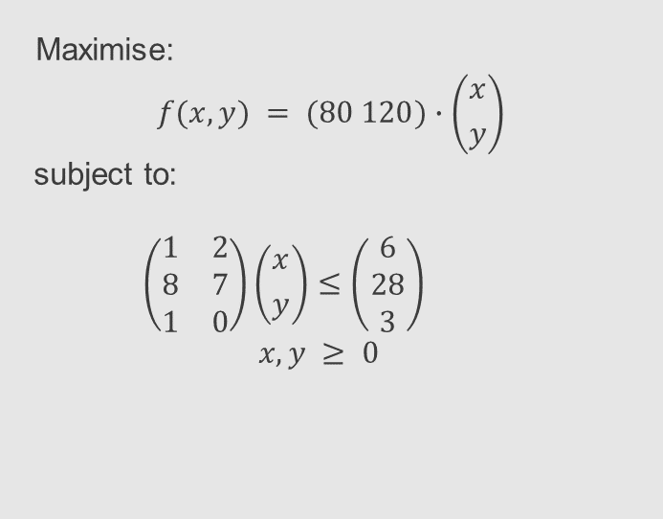
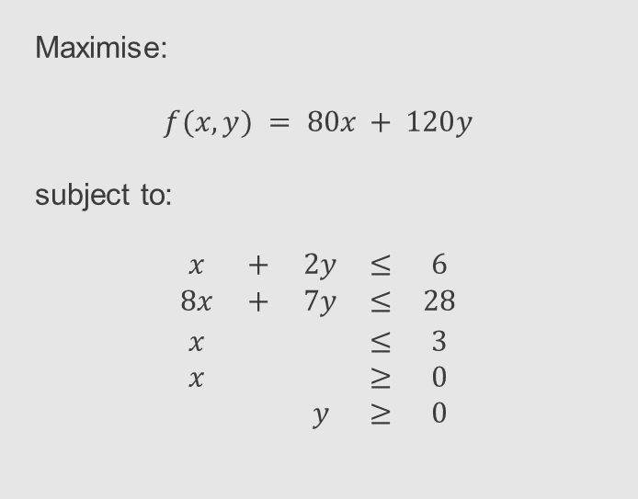
An example – mathematical formulation 2/2
Mathematically, we usually write the problem as follows:
Maximise:
$$f(x,y) = 80x + 120y$$
subject to:
$$\begin{matrix}x & + & 2y & ≤ & 6 \\ 8x & + & 7y & ≤ & 28 \\ x & & & ≤ & 3 \\ x & & & ≥ & 0 \\ & & y & ≥ & 0\end{matrix}$$
Maximise:
$$f(x,y) = (80 120)∙\left({x \atop y}\right)$$
subject to:
$$\left(\begin{matrix}1 & 2 \\ 8 & 7 \\ 1 & 0\end{matrix}\right)\left({x \atop y}\right)≤\left(\begin{matrix}6 \\ 28 \\ 3\end{matrix}\right)$$
$$x,y ≥ 0$$
This is a linear programming problem because both the objective and the constraints can be expressed with linear functions.

Slide 15
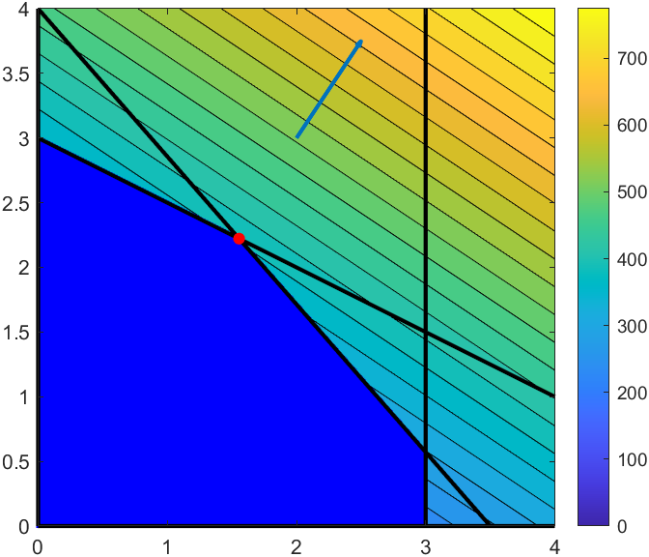
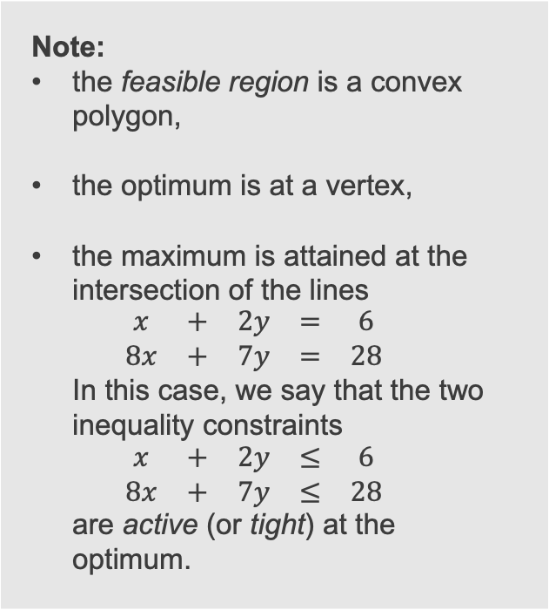
An example – graphical solution (with Matlab) (with Matlab, see OR01_feasible_region.m)
Note:
the feasible region is a convex polygon,
the optimum is at a vertex,
the maximum is attained at the intersection of the lines $\begin{matrix}x & + & 2y & = & 6 \\ 8x & + & 7y & = & 28\end{matrix}$ In this case, we say that the two inequality constraints $\begin{matrix}x & + & 2y & ≤ & 6 \\ 8x & + & 7y & ≤ & 28\end{matrix}$ are active (or tight) at the optimum.

